Slide 1
Fitness Assessment at Sweeney Elementary School
Brendan Gillotti
HPE 476
Fall 2015

Slide 2
Selection of Assessment
How did I come up with the assessment?
In the next few slides, I will explain the different assessments I found and how they were or were not developmentally and instructionally appropriate.
As well as, explaining how some of these assessments contributed to the assessment I chose to conduct.

Slide 3
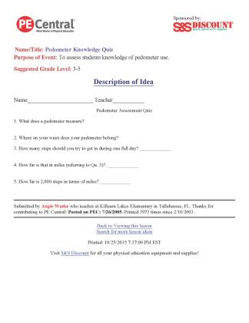
1. Pedometer Quiz Sheets

Slide 4
Why is it a good or bad assessment?
This assessment is developmentally and instructionally appropriate for my class because it adheres to the control level of my class and is directly related to what we are learning in the unit.
I do think this would be a good assessment for my student because it allows for student to show what they have learned and retained over the course of the class rather then being able to show they can do it.

Slide 5
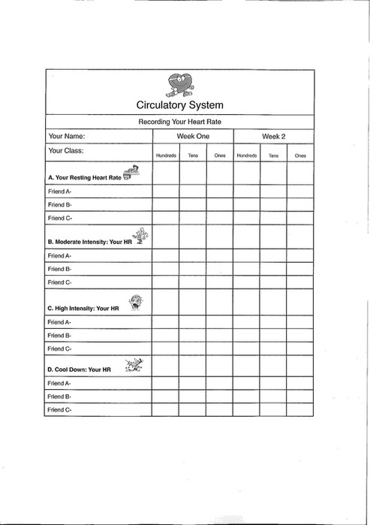
2. Progress Sheets

Slide 6
Why is it a good or bad assessment?
I believe that this progress sheet would be a good assessment for my class because it would give student the chance to track progress while also giving them something to work towards.
This sheet would hold students accountable and honest to their work.

Slide 7
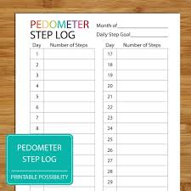
3. Pedometer Step Log

Slide 8
Why is it a good or bad assessment?
This assessment just like the progress sheet would work well in my school setting due to the fact that it is something that tracks growth and is completely independent for the other student in the class which make results more detailed for each student.
This form of assessment give the teacher a chance to see that the students are making improvements as well as gives the student a opportunity to set goals for them self

Slide 9
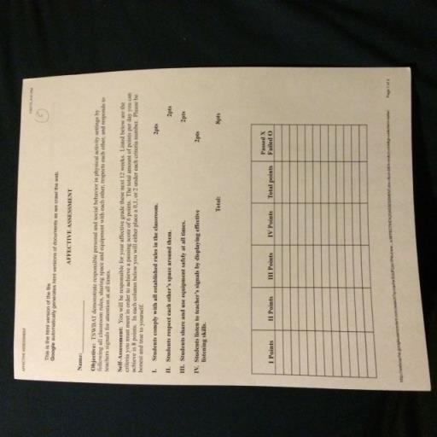
4. Pedometer Affective Assessment

Slide 10
Why is it a good or bad assessment?
This affective assessment would not be an assessment I would use for my classroom.
I believe this test is too complicated for not only the students but for me in general making it not instructionally or developmentally appropriate. Having to constantly assess every student every class would be too difficult for me to fairly evaluate and give feedback on

Slide 11
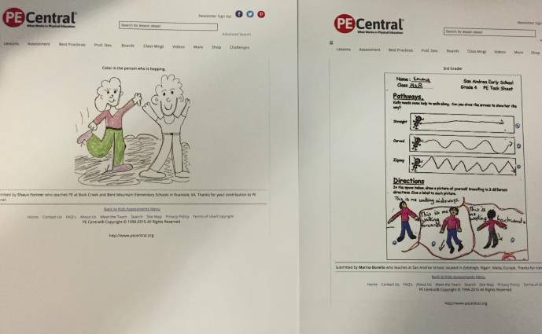
5. Mental Recall Assessment

Slide 12
Why is it a good or bad assessment?
This cognitive assessment is a very easy and valid assessment. This assessment would ask student to draw or color in an area of the body that the pedometer should be warn on.
This test is developmentally appropriate because students are using their recollection of the demonstrations given to show me in their opinion where the best place to wear the pedometer is. This give student who struggle to write the chance to answer the same style of question in regards to where the pedometer should be warn.

Slide 13
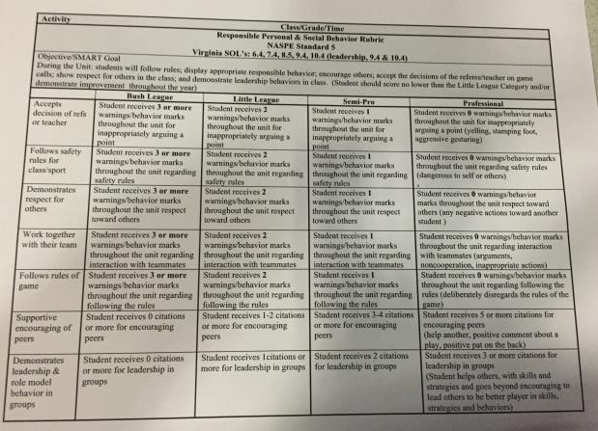
6. Behavior Assessment Sheet

Slide 14
Why is it a good or bad assessment?
This test is developmentally and instructionally appropriate because it assess the basic behaviors a student should be practicing while in the gym or classroom setting
The rubric lays out the criteria for each level this way student know exactly what they did or didn’t do to get the grade they did.

Slide 15
Combining to Create My Assessment
To create my assessment, I took what I thought were the strengths out of all the assessments I found and combined them into 1 assessment.

Slide 16
My Assessment
The assessment I choose to do was conducted in a 3rd Grade Class and the following aspects were assessed:
    1 Cognitive Assessment

Slide 17
Why was this Developmentally and Instructionally Appropriate?
  Instructionally Appropriate: Students were given this assessment at the end of class during the last lesson involving pedometers. This allowed for the student to hear the answers to all the questions numerous time in class prior to taking the written exam.
  Developmentally Appropriate: Students have had previous practice with written exams in there classrooms and this allows for the students to have something visual to represent there learning.

Slide 18
How did I conduct my Assessment?
Students were observed by the teacher and assessed on specific criteria for each different assessment.
If the students showed the criteria they were given 1 point.
Each assessment had 4 distinct criteria.
Each student received a grade of either: Mastery (4pts), Proficient (3pts), Emerging (2pts), Beginner (1pts) or Needs Improvement (1pts) for each domain.
The following slides show the results that students in 1 specific class scored.

Slide 19
Demographics of the Class
18 Students
8 Female Students 10 Male Students
Ages 7-8
Student injuries and other reasons such as not being prepared or not participating were reasons for students not being apart of class.
Numerous absences of multiple students occurred during this assessment

Slide 20
Is this assessment Reliable and Valid?
This assessment is very reliable because it all the questions were pulled from questions asked and answered during opening and closing each class leading up to the assessment.
The assessment is also very valid because it was given to all third grade classes in the school to measure against.

Slide 21
Scoring Rubrics for Assessment
Score 4 = Mastery Level
  Student shows understanding in all criteria listed
Score 3 = Proficent Level
  Students show understanding in 3 out of 4 listed criteria
Score 2 = Emerging Level
  Students show understanding in 2 out of 4 listed criteria
Score 1 = Beginner Level
  Students show understanding in 1 out of 4 listed criteria
Score 0 = Needs Improvement
  Students do not show understanding in any of the listed criteria

Slide 22
Cognitive Assessment:
Knowledge of Skills
This assessment that I conducted was both a written and performance based assessment that showed if students understood concepts, rules and usage of the pedometers.

Slide 23
Knowledge & usage Criteria
Students will be assessed on the following format for the forehand hit:
Students will receive 1 point by demonstrating competency in each category
  Carries pedometer correctly when walking with it
  Shows understanding of proper way to put it on
  Shows understanding of how to reset pedometer
  Follows all safety rules that go with the pedometers.

Slide 24
Knowledge & Usage Assessment Data Sheets

Slide 25
Knowledge & Strategies Results

Slide 26
Written Test Characteristics
This cognitive assessment was conducted to see if the students understood concepts writhing the things they have learned about using pedometers
This was a 4 question test that involved pictures and explanations of pedometer use.

Slide 27
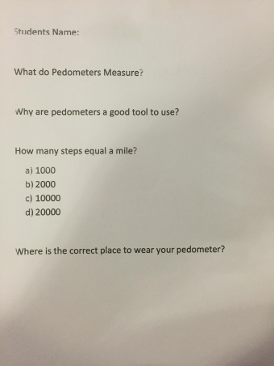
Written Test Example

Slide 28
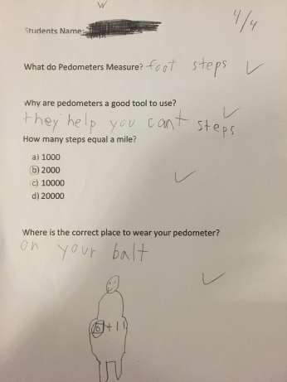
Example of a High Score on Quiz

Slide 29
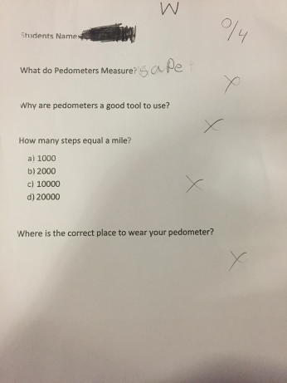
Example of a Poor Score on Quiz

Slide 30
Written Test Score Results
Name of Student | Written Test
 | Results (out of 4 pts)
A | 3
B | NA
C | 3
D | 2
E | NA
F | 3
G | 2
H | NA
I | 3
J | 3
K | NA
L | 3
M | 0
N | 2
O | 4
P | 4
Q | 2
R | 3
 | Written Test Average= 3.2

Slide 31
Written Test Scores

Slide 32
Sharing Results
Each student received their results back on a photo copy of their original exam. This now gave them something to bring home and learn from.
Answers were reviewed as a class with the papers in front of the students allowing them the opportunity to mark the correct answer down for future reference.

